Slide 1



R Roundtable Session 29.11.16
Installation, setup and use of Github
Doro Hodapp dorothee.hodapp@uni-oldenburg.de
Dominik Bahlburg dominik.bahlburg@uni-oldenburg.de

Slide 2
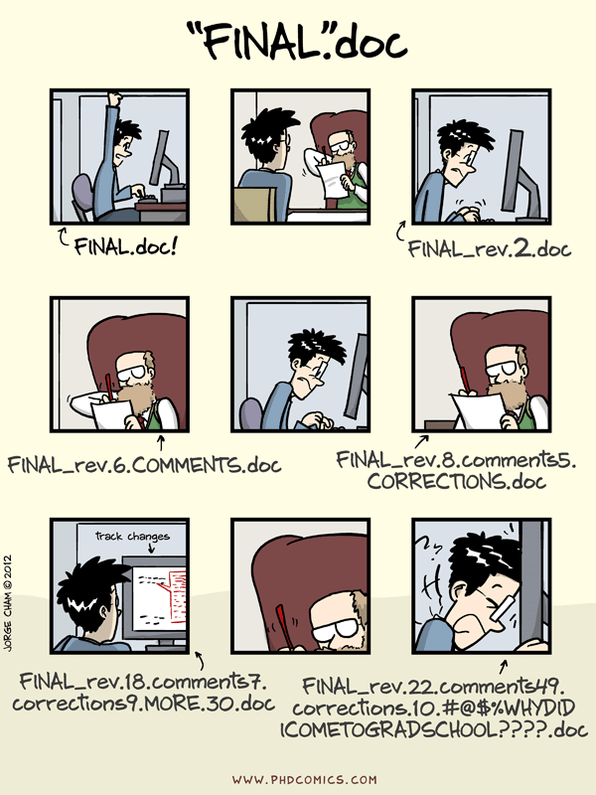
What is Github? Why should I use it?
Version control
Collaboration
Backup
Exchange platform

Slide 3
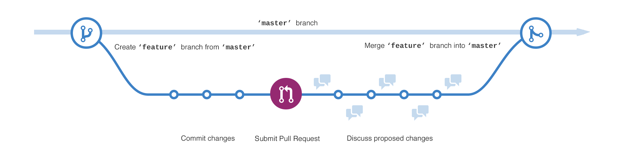
Github workflow

Slide 4
Github Setup
Go to the Github webpage and sign up for an account. https://github.com/
Create Github account at http://github.com, if you don’t already have one. For username, I recommend all lower-case letters, short as you can. If possible use your university email address, since you can request free private repositories via GitHub Education discount.
Download the GitHub installer here: https://git-for-windows.github.io/ Select "Use Git from the Windows Command Prompt" and click on "Next" Keep "Checkout Windows-style, commit Unix-style line endings" selected Select "Use Windows' default console window" and click on "Next" This will provide you with both Git and Bash in the Git Bash program.

Slide 5
Github Setup
Then download and install the GitHub Desktop App: https://desktop.github.com/
Configure Desktop App as described here:
https://help.github.com/desktop/guides/getting-started/authenticating-to-github/
Configure Git for Github Desktop as described here:
https://help.github.com/desktop/guides/getting-started/configuring-git-for-github-desktop/

Slide 6
Github Setup
You also need to have R and Rstudio installed on your computer.
Configure git with global commands. Open up the Bash version of Git and type the following:
# display your version of git
git --version
# replace USER with your Github user account
git config –-global user.name USER
# replace USER@UMAIL.UCSB.EDU with the email you used to register with Github
git config –-global user.email USER@UMAIL.UCSB.EDU
# list your config to confirm user.* variables set
git config --list
Download and install a text editor, e.g. notepad++ https://notepad-plus-plus.org/download/v7.2.html Be aware that you must add its installation directory to your system path.
Type this into your Git Shell:
git config --global core.editor "'C:/Program Files (x86)/Notepad++/notepad++.exe' -multiInst -notabbar -nosession -noPlugin"

Slide 7
Basic stuff you do on GitHub..
Create/delete/fork/push/pull a repository
Clone a repository to your local machine
Commit changes and synchronise with the GitHub server via the Github Desktop App
Work on a project directly via Rstudio
(File -> New Project… -> Version Control -> Git -> insert URL of
existing project on Github)

Slide 8
What will we use Github for?
Organisational Platform: insert date, title and content of a session your intending to prepare
Provide session relevant information (necessary packages, links, ..) in advance (by Monday night..)
Provide session material (code, presentation,..)
R Roundtable Github page
https://github.com/dbahlburg/R_Roundtable

Slide 9
Github help pages ..
https://guides.github.com/activities/hello-world/
https://guides.github.com/introduction/flow/
https://guides.github.com/features/wikis/

Slide 10
Setup of Github on a Mac
The default shell in all versions of Mac OS X is Bash, so no need to install anything. You access Bash from the Terminal (found in /Applications/Utilities).
For OS X 10.9 and higher, install Git for Mac by downloading and running the most recent "mavericks" installer from here:
https://sourceforge.net/projects/git-osx-installer/files/
After installing Git, there will not be anything in your /Applications folder, as Git is a command line program. Also, please install the Github Desktop app.
For older versions of OS X (10.5-10.8) use the most recent available installer labelled "snow-leopard" available here:
https://sourceforge.net/projects/git-osx-installer/files/
Then also install the Github Desktop app.

